Slide 1
Boiling a frog
Matic Tribušon
Sr. Director of Engineering @Celtra
https://www.linkedin.com/in/3buson/ Celtra is hiring! https://bit.ly/3vHInsg

Slide 2

When boiling a frog, place in cool water and slowly turn up the heat.
Notes:
You are probably familiar with the story of boiling a frog.
If you’re not, here’s a short recap - the tale says that if you want to boil a live frog you should put it in the cold water and then slowly heat the water. The frog will not notice the heat increase and it will enjoy boiling to death. So if you ever want to do that, now you know - don’t throw the frog into boiling water, it will jump out.
Very similar things tend to happen in software development, just that we are the frogs in that case. Sadly. You probably see where I’m going with this.
I’m going to try and show you that too often we boil like frogs and end up with unreadable spaghetti code without even really noticing when it happened.

Slide 3
01 Context
02 Component Case Study 1
03 Component Case Study 2
04 Conclusion
Notes:
First I’m going to give you some context of what we do @Celtra, just so it will be easier for you to understand the examples and case studies we will cover.
Then we’re going to take a look at some examples or case studies and we’ll try to figure out what exactly went wrong and what actions can we take in effort to mitigate the risk of this happening. We will conclude the talk with some takeaways.

Slide 4
What do we do @Celtra?
Notes:
To easier understand some of the examples - what does Celtra do?
Here everything revolves around creative. We build amazing software to help people create great ads at scale. Our tool handles the whole process from ad or creative creation to distribution. A basic flow would be - create templates, import the content like imagery and text, combine the templates with content to generate thousands of creative variants. Review and approve them. And in the end distribute them to advertising platforms like Facebook, GoogleAds and so on.

Slide 5
Component Case Study Input.vue
Notes:
We also have an internal design system where all the building block live. And our first case study features a Vue.js component called input. You probably roughly imagine what this looks like.

Slide 6
How hard can it be? *
* as it turns out, quite hard. There are a lot of cases to cover
Notes:
It’s just an input component - how hard can it be right?

Slide 7
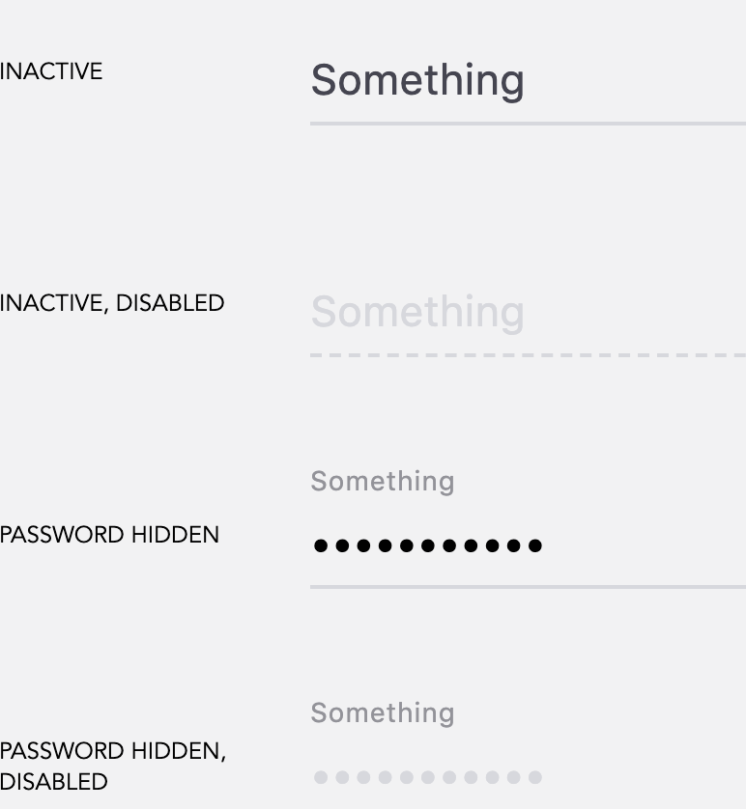
Simple Input component
Some fancy animations
Some icons
A few states
Some validation
Notes:
Looking at the input itself, it seems we have a few states to cover, some animations and icons and some validation.

Slide 8
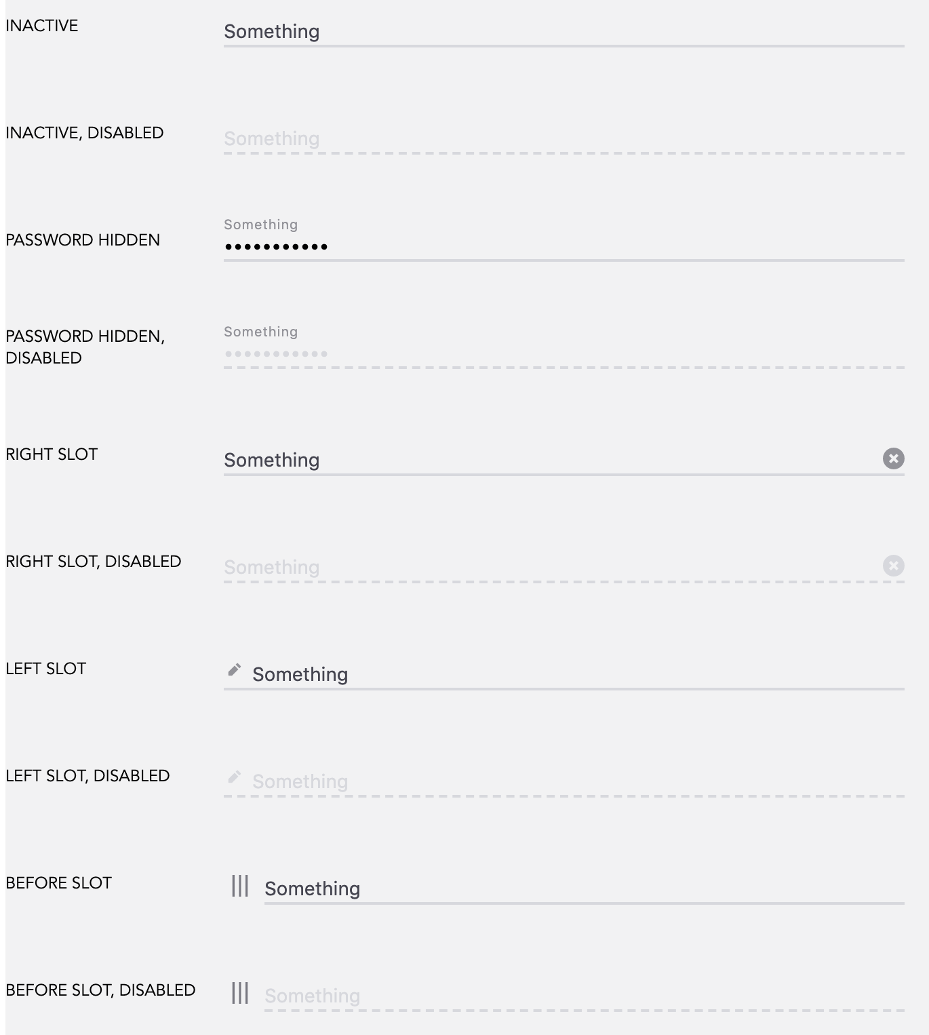
Simple Input component
Some a lot of animations
Some >10 different icons
A few ton of states
Some A lot of validation
Notes:
But as it turns out this task is far from being easy. If we look closer and once we start enhancing the input we see that there is a shit load of states to cover, a lot of cases where we need different icons on different places, loads of animations and a lot of validation that the components needs to do.

Slide 9
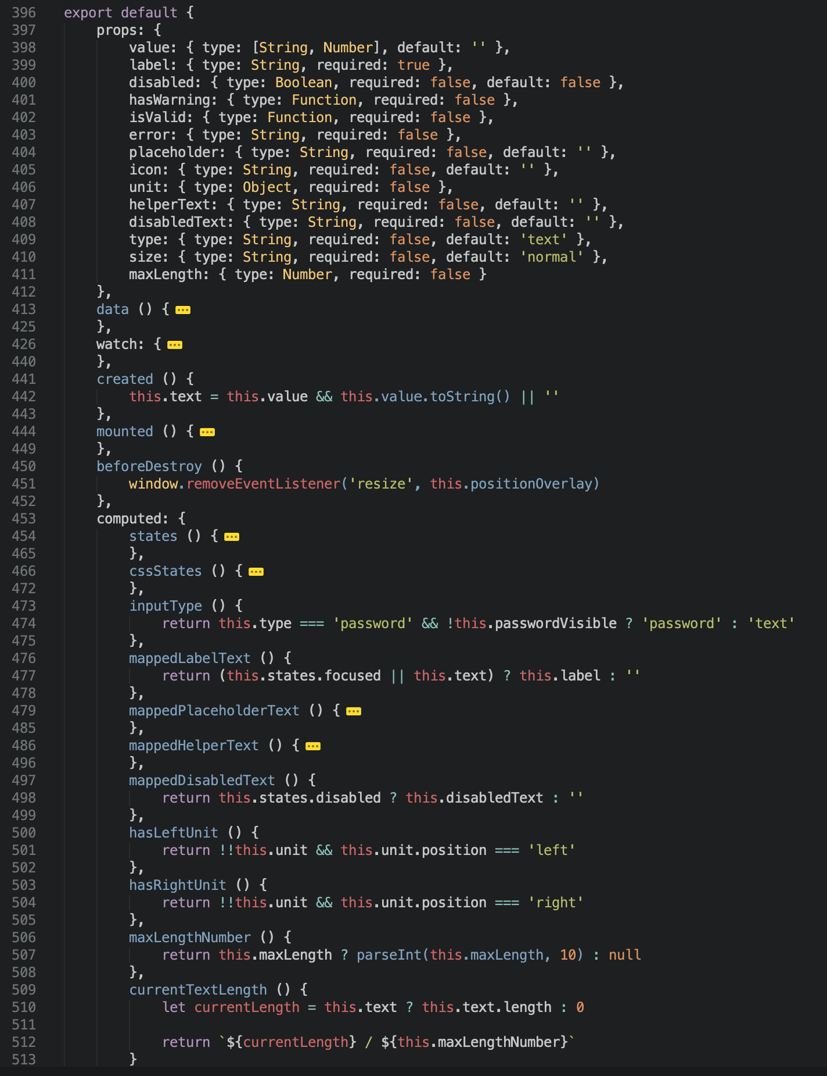
* just a portion of the component displayed
v1
Notes:
So here is the v1, of course a portion of it. What I want you to pay attention to are the props. Props basically define how many states a component can have. Not all combinations are usually possible, but still. Even here we can see a hefty number of props, 14 if I’m not mistaken.
We’re most definitely not proud of that component even at the time we first released it. But still, life with it was not a complete disaster.

Slide 10
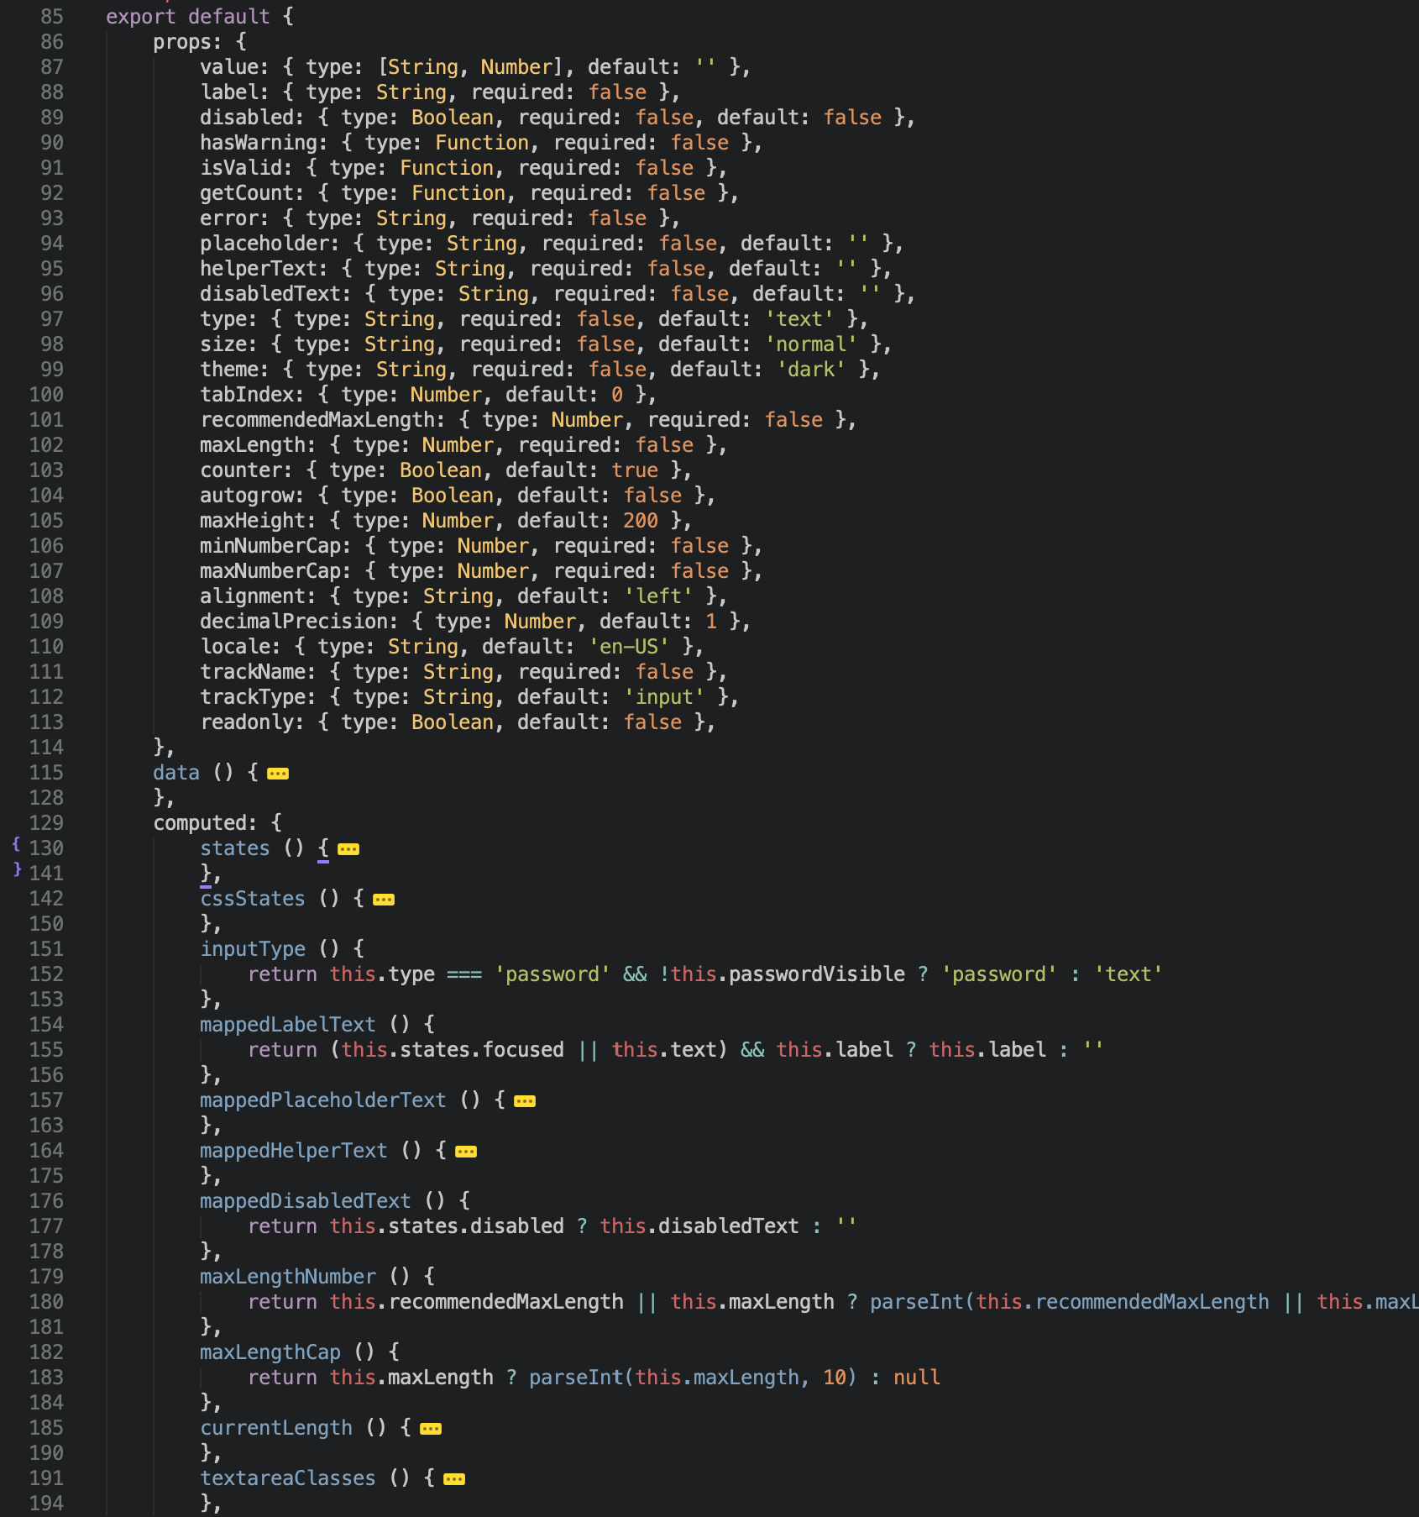
* just a portion of the component displayed,
not the actual version number :)
v534
Notes:
Now let’s take a look at what a few years of changes did to it.
Again, just a portion of the component displayed, but the same portion as before. Let’s quickly switch between the two. You can clearly see an explosion of props. Now we have 27 of them. Imagine, 27 bits you can configure separately and each one does something. In an input!
You can also imagine that other parts on the component grew proportionally and using it is a disaster now. Let’s not even start discussing about how hard doing changes or implementing new features is.

Slide 11
What is wrong?
Component handling too many cases
Hence to many props (even in v1)
Hence too many states
New cases = new props
Bad component design
Notes:
So what’s wrong? Obviously we didn’t do a good job from the start and that certainly did not help in the long run.
But generally the component is handling too many cases. How do we know that - 27 props!
Because the component has a lot to do there is a lot of code, there is a lot of props and a lot of states. When the component evolves it’s bound to get more and more props if we’re not super careful. And such design - having an all-in-one component speeds up this procedure. If a component already has 26 props, I can surely add another one right?

Slide 12
What is the solution?
One component ‘per case’
Base input
Text input
Number input
Split input and furniture
Base field
Text field
Number field
Notes:
So what’s the solution then?
We’ve already established there’s just too much for one component to handle. The solution is of course to break down the component.
If we take a look at some of the props, like minNumberCap & maxNumberCap we can see this input probably handles number input amongst other things. Autogrow and max height suggest that this can be a textarea as well. So by even glancing at the props you can probably think of a sensible way of splitting up this component.
If we take a look at the style once again on the right you can also see there is a line you can draw between the actual input and the furniture around it - like the label, helper text, icons, etc.
If we combine the two, and for simplicity let’s just leave textarea out, we could split it out like this:
We have a set of inputs. Base input, text input and number input.
Then we have a set of fields - those components handle the mentioned furniture - base field, text field and number field.

Slide 13
* textarea case left out for the sake of simplicity
BaseInput = plain input & listeners
TextInput = BaseInput + handling of password case
NumberInput = BaseInput + handling of numbers
BaseField = basic furniture → animations & styling
TextField = BaseField + TextInput
NumberField = BaseField + NumberInput
Notes:
Base input, as the name suggests, really takes care of the basics - plain html input and listeners.
Text input is a base input plus handling of password case that has to hide the input and some minor additions.
Number input is base input and handling of numbers - things like min and max allowed number, step between possible inputs etc.
Then we have fields in similar fashion - base field, text field and number field.
Base field takes care of the shared furniture & animations.
Number field is a base field and a number input and text field is a base field and a text input.

Slide 14
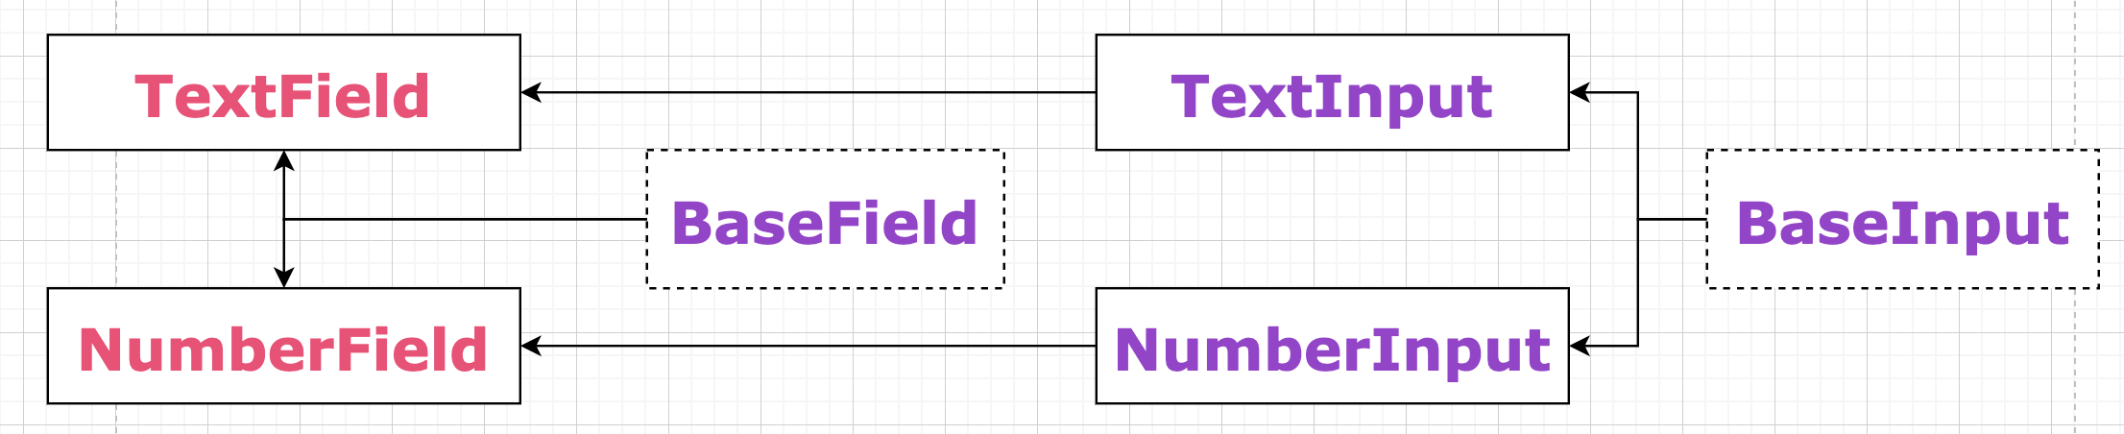
* textarea case left out for the sake of simplicity
Notes:
This is how it looks if we map it out.

Slide 15
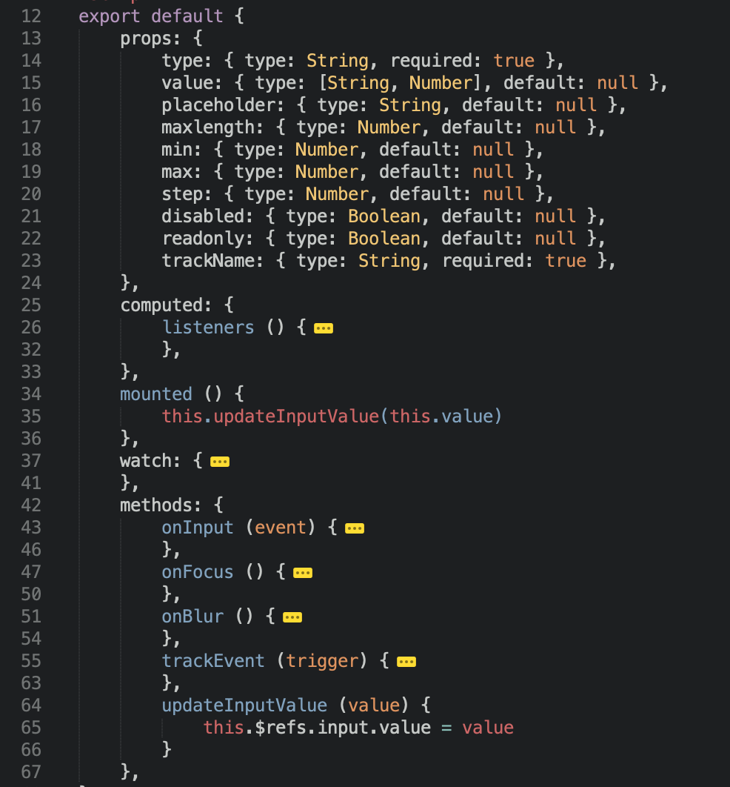
* just a portion of the component displayed
_BaseInput
Notes:
Now let’s quickly take a look at the props part of those components, just so you can see how much cleaner things are.
Base input now has 10 props, not that little but some are needed just to be passed through to the input HTML element - like min, max and step.

Slide 16
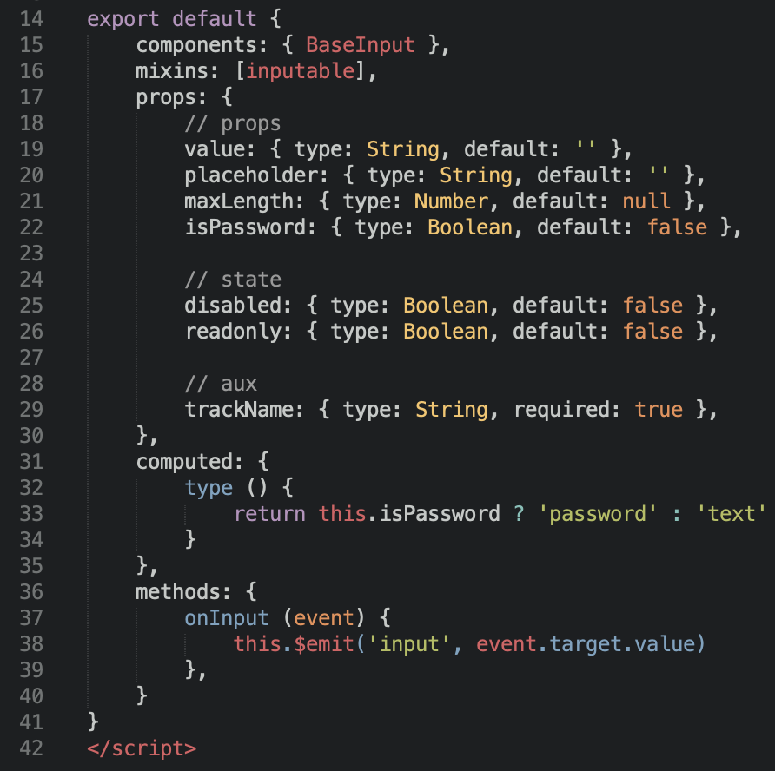
_TextInput
Notes:
Text input has even fewer props, it does not need the numbers stuff. It has a bool denoting if we have a password input and the only computed prop also handles the password case.

Slide 17
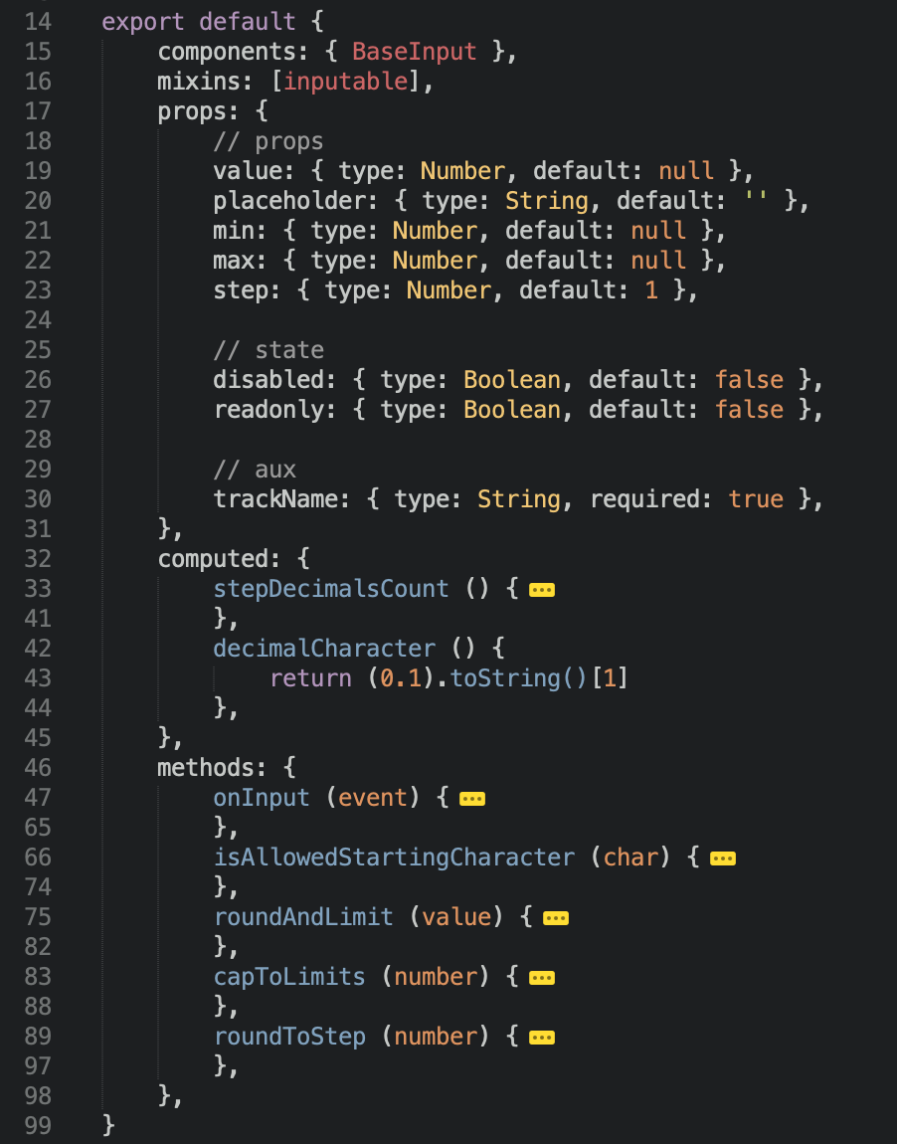
_NumberInput
Notes:
Number input does not handle the password case, but it handles the number cases.

Slide 18
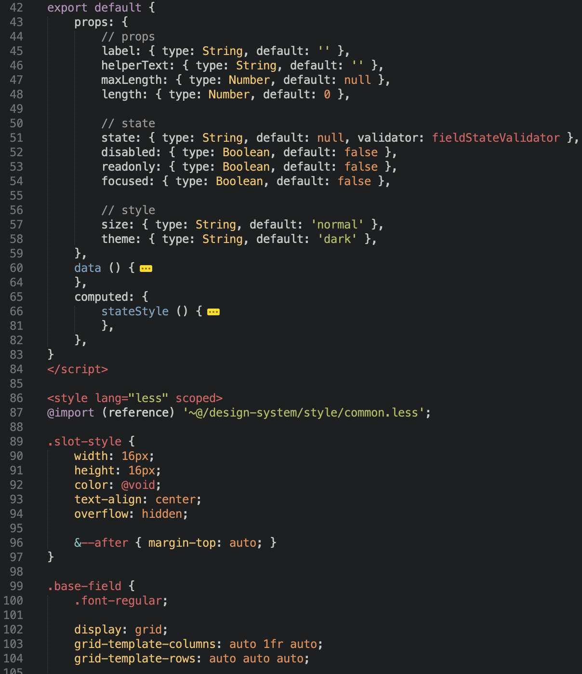
* just a portion of the component displayed
_BaseField
Notes:
In a similar fashion base field relays all the props that are field related to the furniture. There’s more style and less logic here.

Slide 19
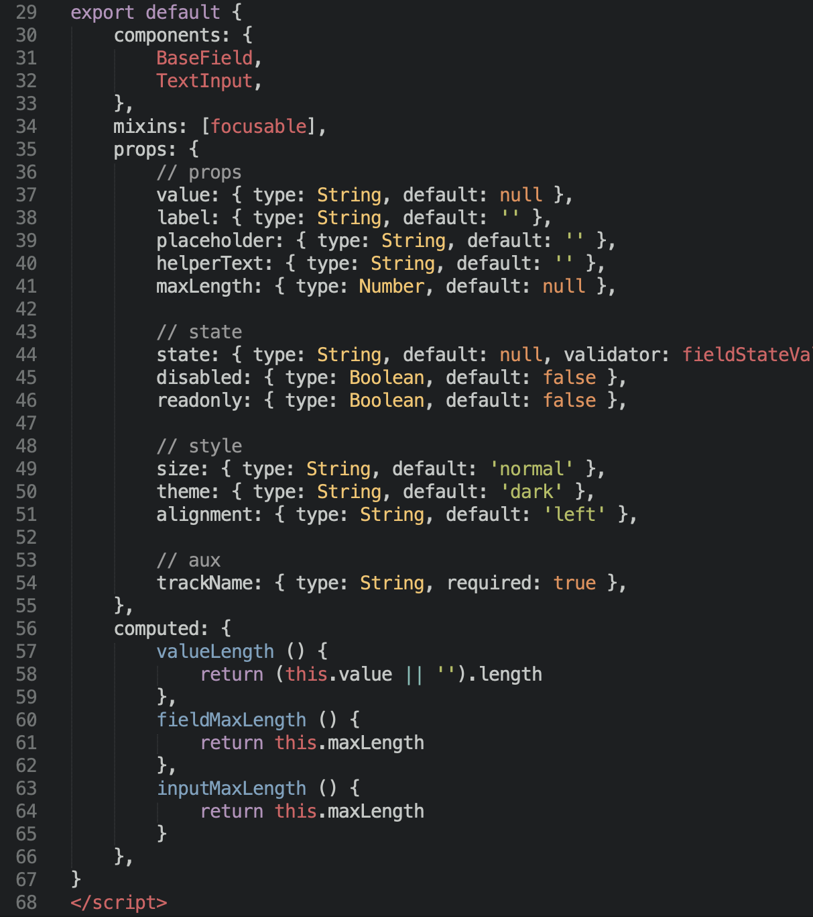
TextField
Notes:
Text field has some extra text related furniture props like max length to display the maximum number on the character counter.

Slide 20
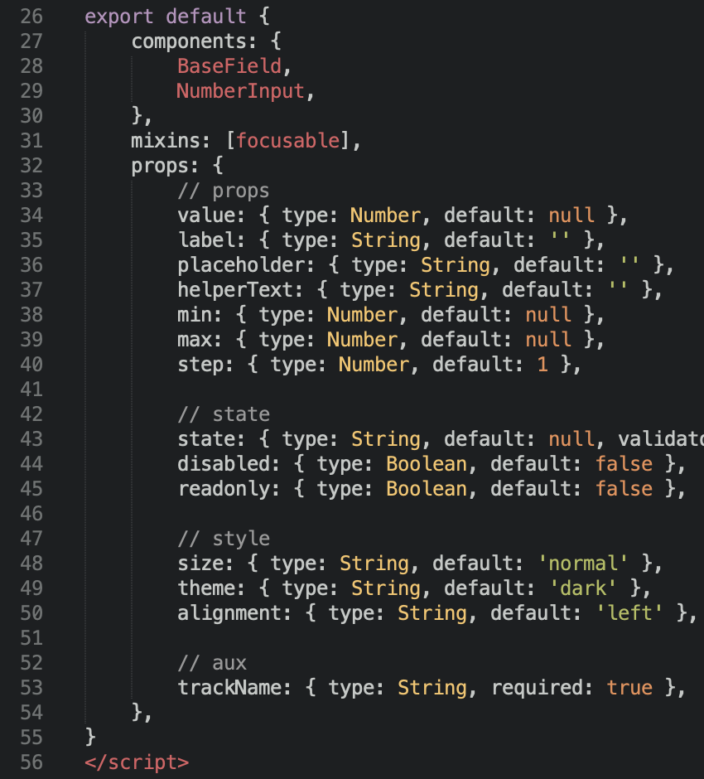
NumberField
Notes:
Number field has number related props so it can pass them down to number input and some basic furniture props like state, size and theme.
So that’s it. Instead of one we have 6 components that are much smaller and cleaner. Changing the logic is much easier since you know where to find what. Also QA is easier since we can only QA number input if we changed something re. numbers.

Slide 21
Component Case Study Distribution.vue
Notes:
Okay, we’ve solved the input, let’s move on to the second case.
Second case study features a more complex and domain specific component called Distribution.vue

Slide 22
What does Distribution.vue do?
Create creatives → review & approve → distribute
Transferring creatives from Celtra to 3rd party vendors
3rd party vendors
Facebook
Pinterest
Twitter
Snapchat
Google Ads
...
Notes:
Let me give you a bit of background.
If you recall the beginning of the talk, I mentioned that here @Celtra we do software for producing creatives for all sorts of channels at scale. This means that once you produce thousands of creative variations in all the languages you need and you reviewed them, you have to distribute them somewhere.
The destinations would usually include platforms like Facebook, GoogleAds, YouTube, Pinterest, Twitter, Snapchat and so on. So distribution is the process of transferring the creatives from Celtra to 3rd party platforms.
And of course we have a frontend part of it, where the users choose which ads should be distributed where.

Slide 23
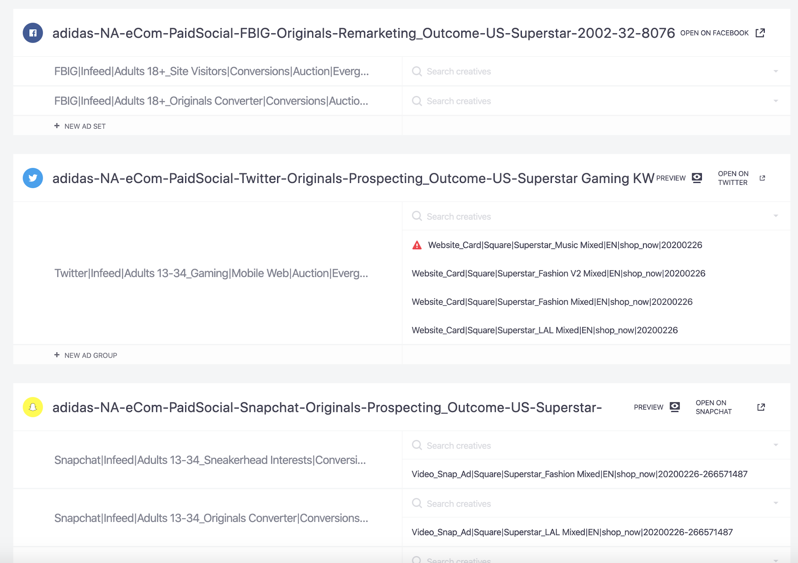
Notes:
This is how a distribution component looks in our platform.
There’s actually 3 of them in this picture. Every one represents an advertising campaign in a specific 3rd party platform. We have Facebook, Twitter and Snapchat. If you know how advertising on social works you’re familiar with ad sets, if not don’t worry. Basically each of those distribution components has a campaign name on top - the name of the linked 3rd party campaign. Then it has ad sets on the right and an input where you can choose creatives from Celtra to be distributed to this ad set on the left.
Of course if you already distributed some, they also appear on the left.
You can imagine there are some differences between the platforms but they also share a lot of common things.
But enough of boring things, let’s look at the code!

Slide 24
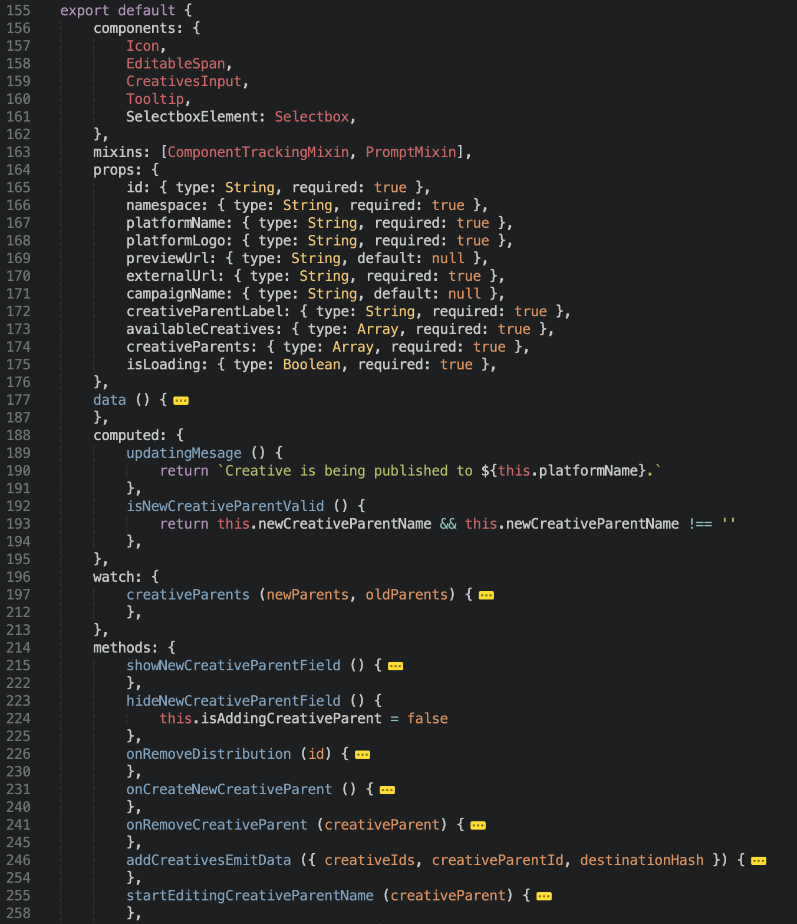
* just a portion of the component displayed
v1
Notes:
We have one component to rule them all – Distribution.vue. It’s the same component handling Facebook, YouTube, GoogleAds, Pinterest and so on.
Similar to the other case study - this is how a portion of version 1 looks like. We have around 10 props. Not great, not terrible. There’s a few computed props and some more methods.

Slide 25
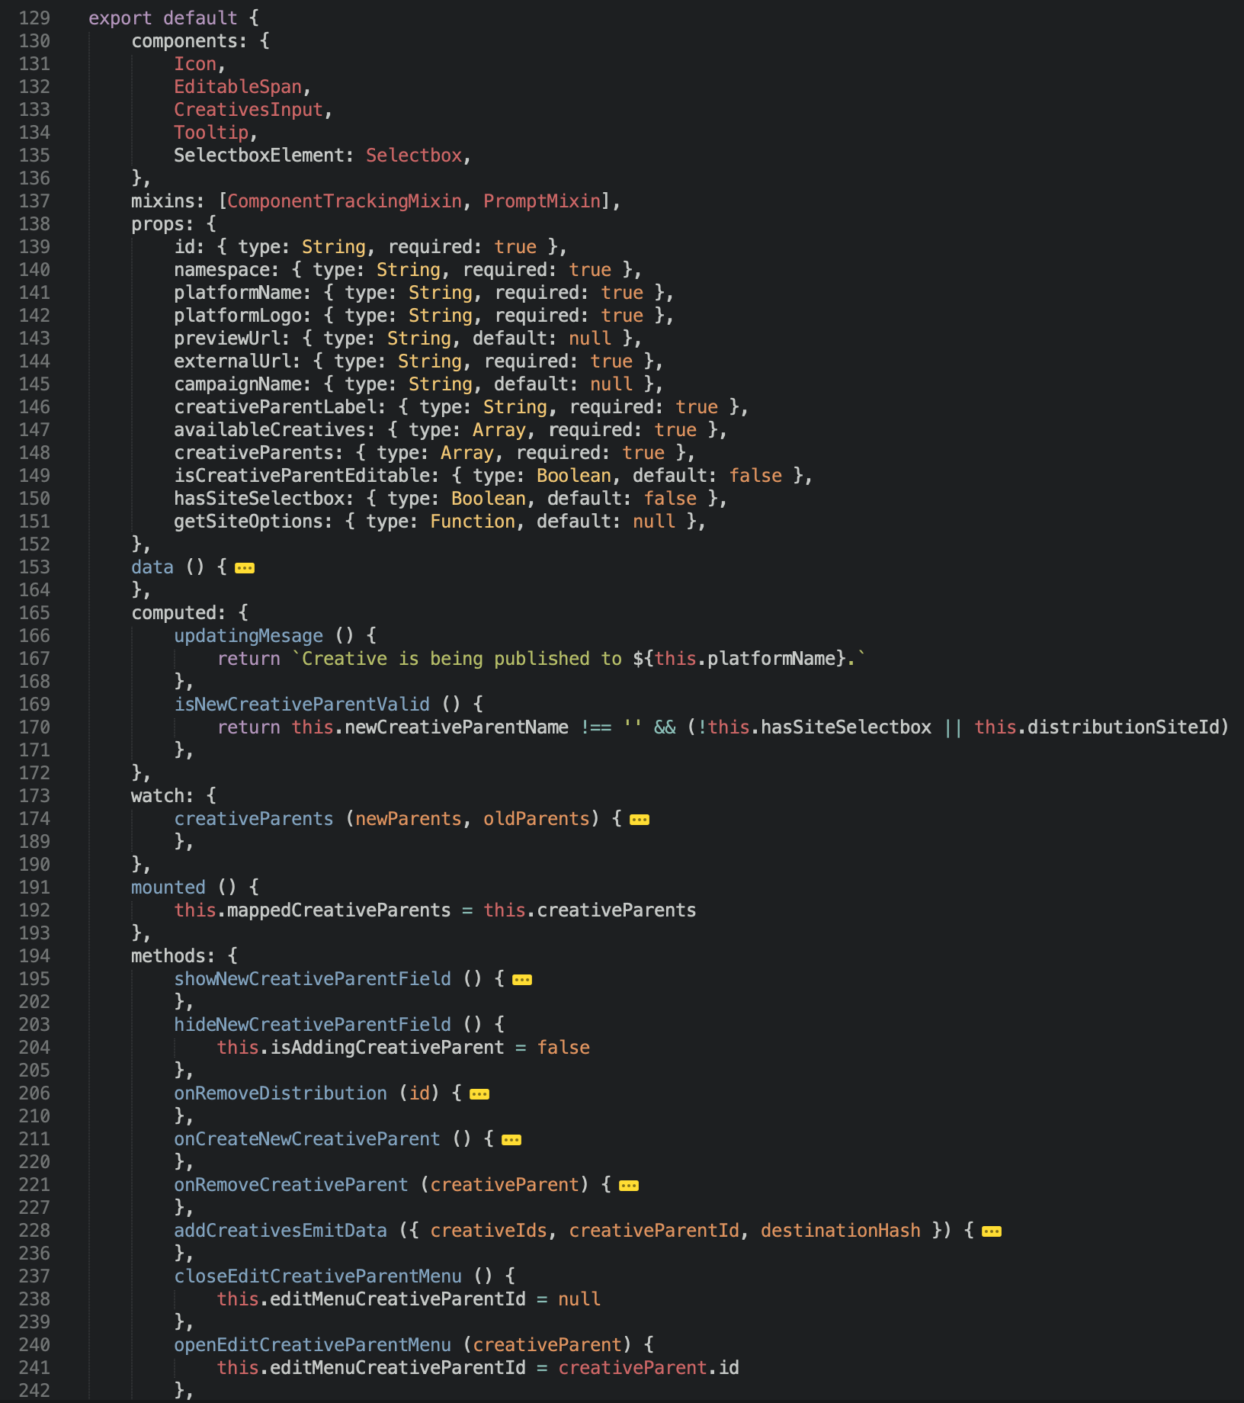
* just a portion of the component displayed,
not the actual version number :)
v153
Notes:
As we started adding more and more 3rd party platforms the component stayed the same architecturally.
Quite some commits later, that’s what we have. The number of props rose a bit, to 13 and proportionally other things grew as well. But right away we can see that we added some weird looking props like hasSiteSelectbox and getSiteOptions. It looks like the site is something specific you have to select for a specific 3rd party platform. And because there is only one component we have to force feed this specific case to it.
What if we have to add a distribution platform the does not have the concept of ad sets? Or if it requires some other parameters when distributing creatives?
Everything will need to be handled by this component and the complexity will grow quickly.

Slide 26
What is wrong?
At first 3 distribution vendors, now 9 and counting
New cases = new props (+3, not terrible)
New cases = bloated template
Explosion of methods (20+)
Store and it’s modules grew accordingly
Notes:
So what went wrong this time? Well, similar things. The component wasn’t that bloated from the start but it still did a lot of things from day one. And on day one it just supported 3 platforms, now it has to support 9 and counting! You can imagine there has to be quite some v-if statements in the template :)
Because the component again does a lot of things, we now have an explosion in methods - all the listeners and stuff.

Slide 27
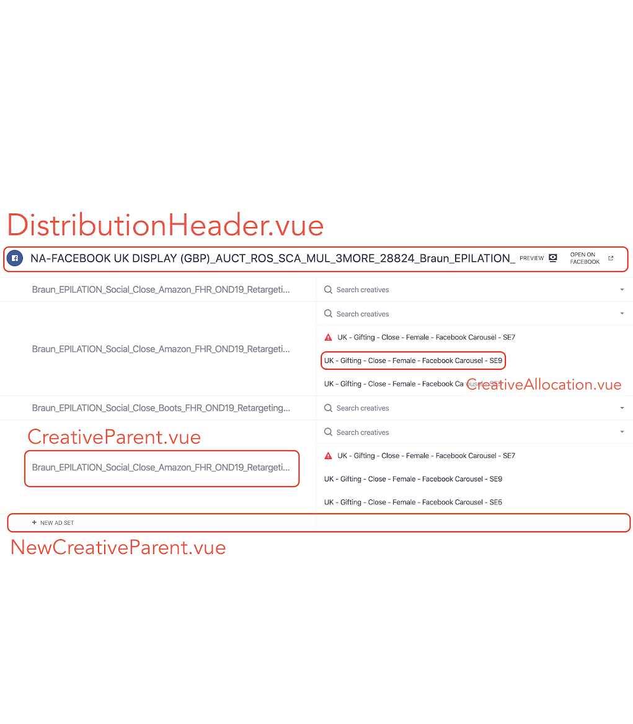
What is the solution?
Component breakdown
DistributionHeader
CreativeParent
NewCreativeParent
CreativeAllocation
Notes:
In this case the refactor is already done and I can tell you first hand it does make a big difference on a daily basis.
We have a Distribution.vue component on the right, just like we had 3 of those in the intro slide of the case study. If you look at it closely you can see we can easily split it out into a bunch of components.
There is a header that is totally separate, the ad sets on the left can be a component as well, adding a new ad set can be another component. On the right we can have a separate component that would only handle displaying and interactions with every distributed creative.
This also helps us handle different cases of different platforms better. We can even replace parts of the Distribution.vue with other specific components if we need to.

Slide 28
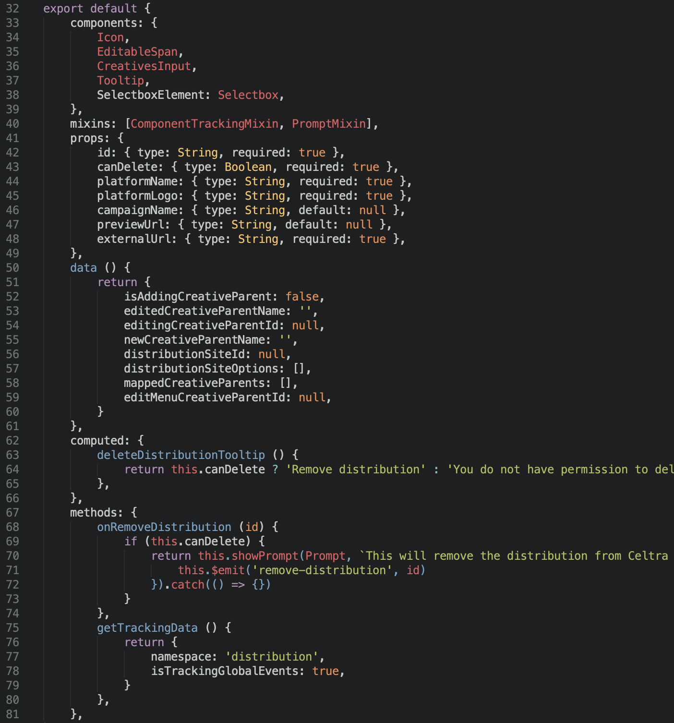
DistributionHeader
Notes:
So now we have DistributionHeader, it’s pretty simple, it gets a few props, has only one computed prop and 2 methods, one of which is only for tracking purposes.

Slide 29
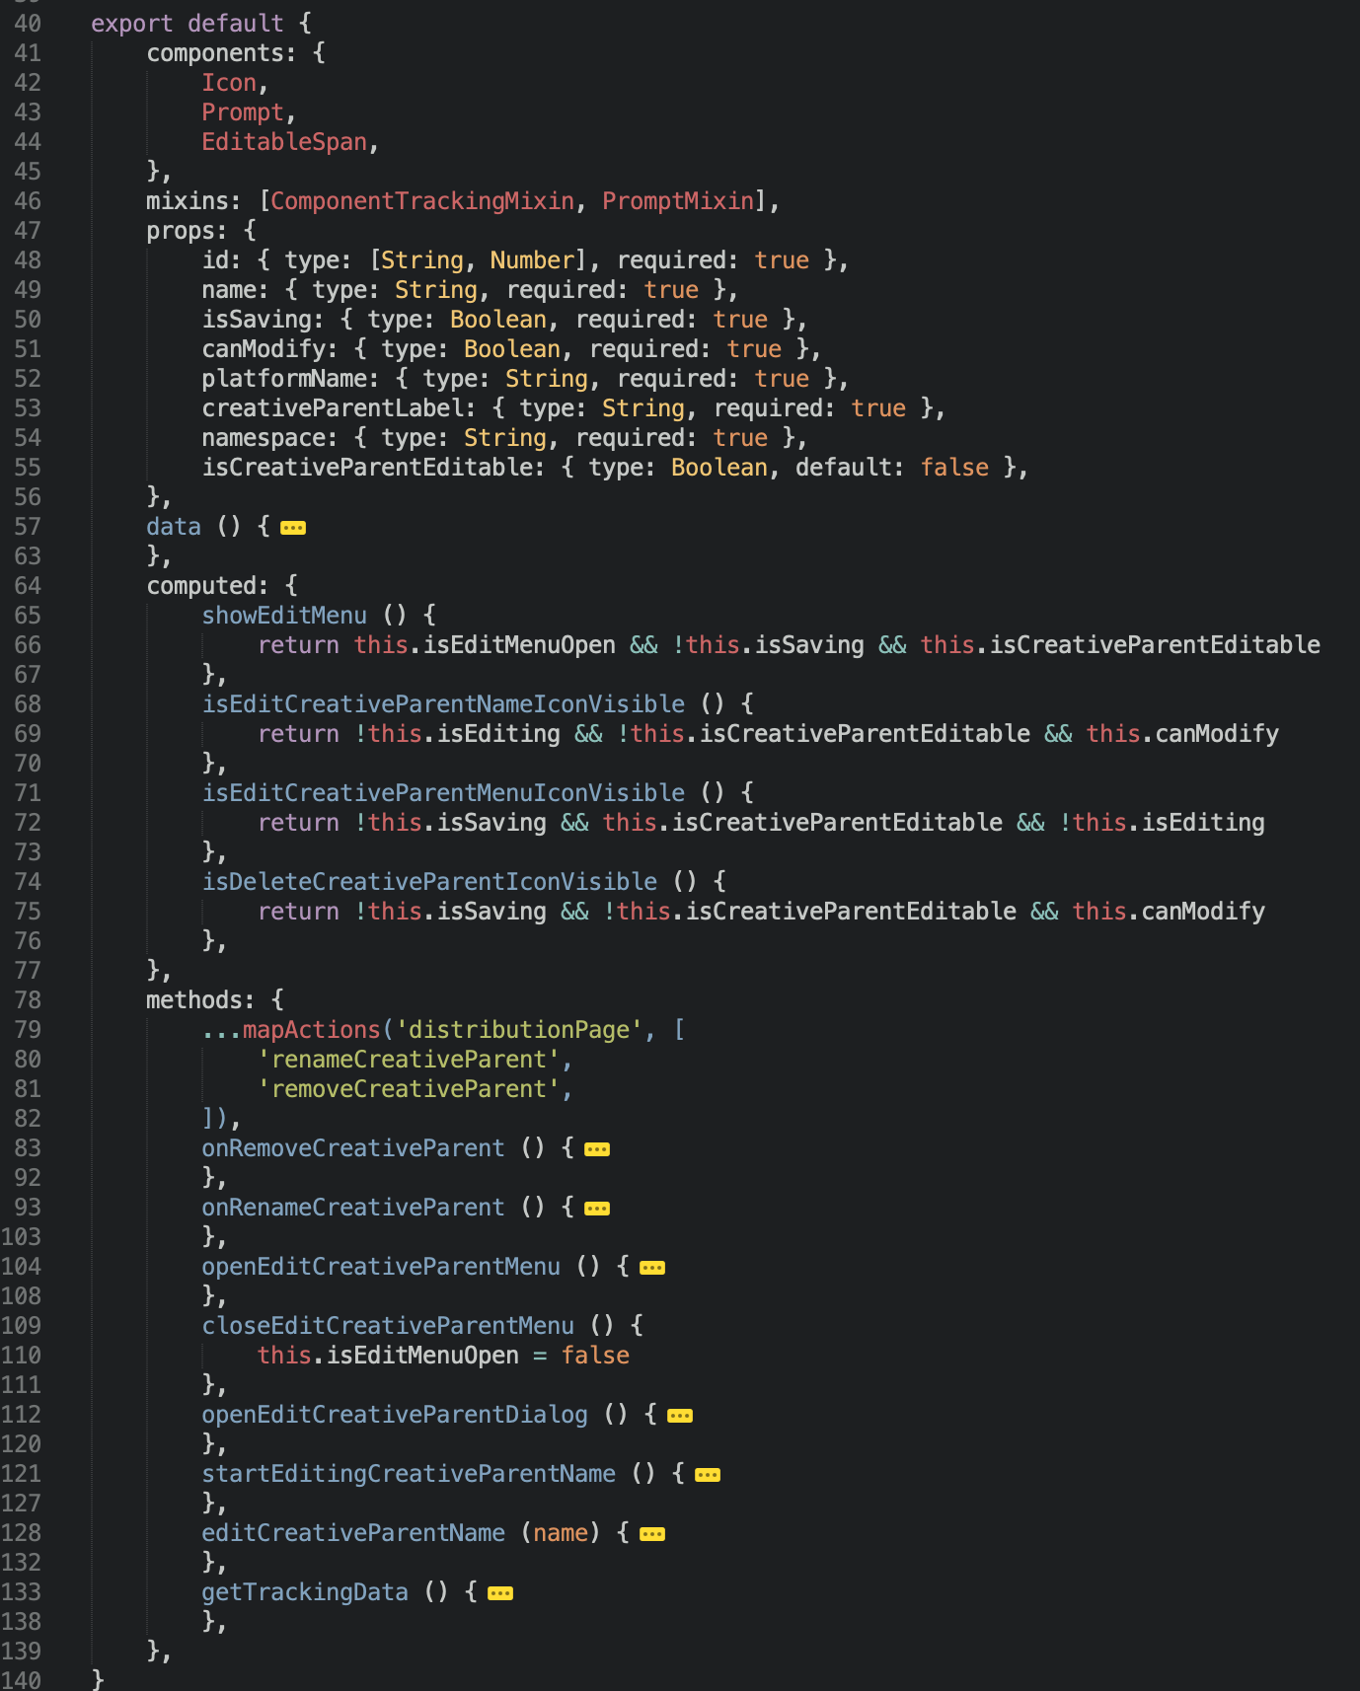
* just a portion of the component displayed
CreativeParent
Notes:
The CreativeParent handles displaying of the creative parents - mostly called ad sets by 3rd party platforms.
That is why we chose a more general name.
This one has a similar number of props and a bit more methods as there are more user actions possible here.
And if we have platforms that do not have the concept of creative parents or ad sets, we can just not include this component in such cases, great.

Slide 30
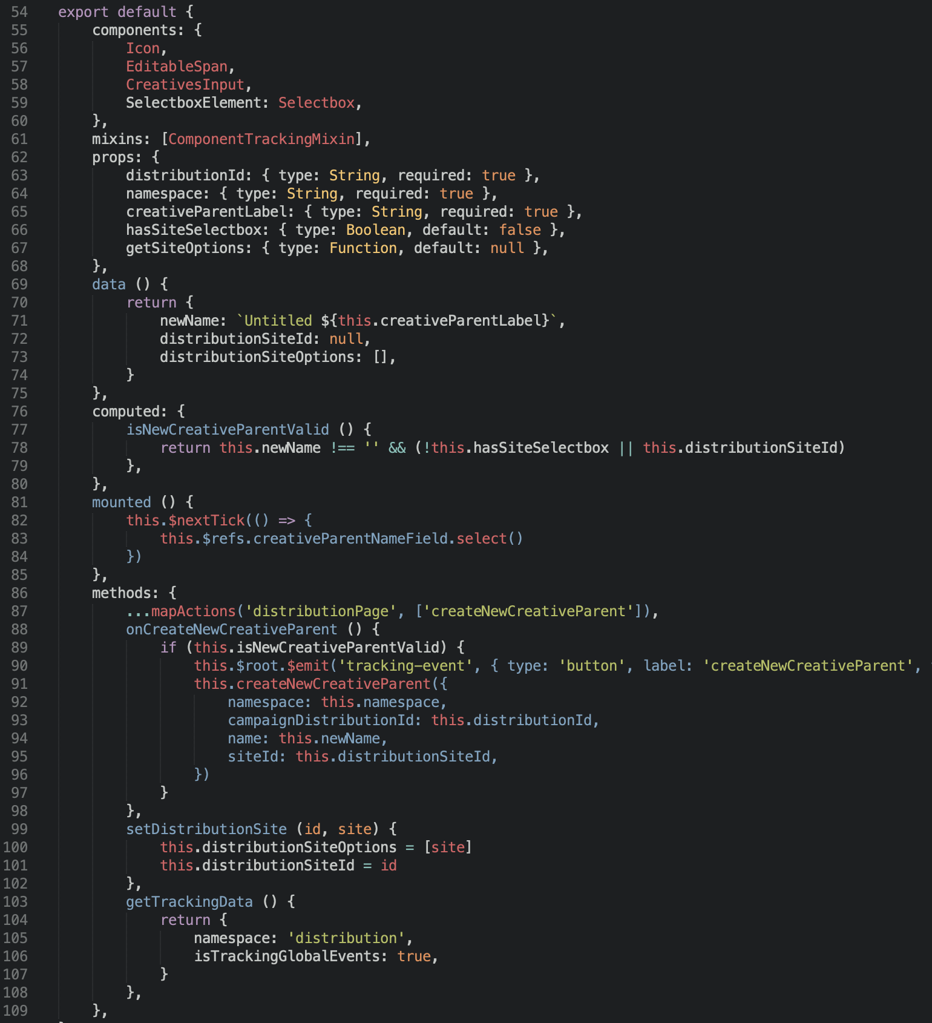
NewCreativeParent
Notes:
NewCreativeParent component only handles the creation of new creative parents, as the name suggests. Very few props, one computed prop and a few methods.
Again, can be left out for platforms that do not have this creative parent concept.

Slide 31
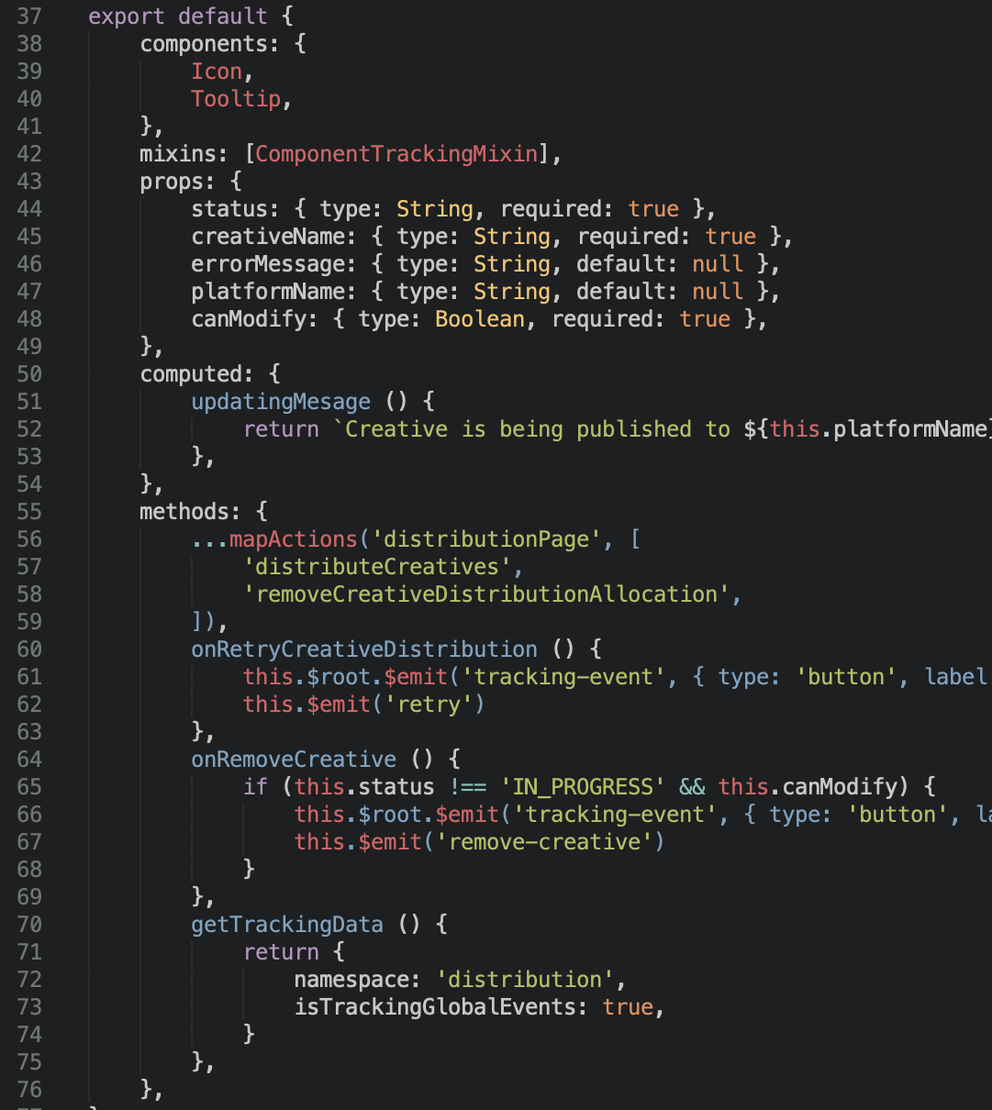
* just a portion of the component displayed
CreativeAllocation
Notes:
Last is CreativeAllocation. This one handles showing every distributed creative and all the actions users can do with it. Also very simple, 4 props, 1 computed prop and a few methods.
Living with those 4 components instead of one big boy really makes the difference. They are much more clean and you know exactly where to find specific stuff. Also changing things is much easier as the testing scope is limited to one portion of the whole Distribution.vue component.

Slide 32
Bonus: what about the Vuex store?
Notes:
Same principles apply! Be mindful of the responsibilities of modules and resort to splitting into multiple modules when you can.

Slide 33
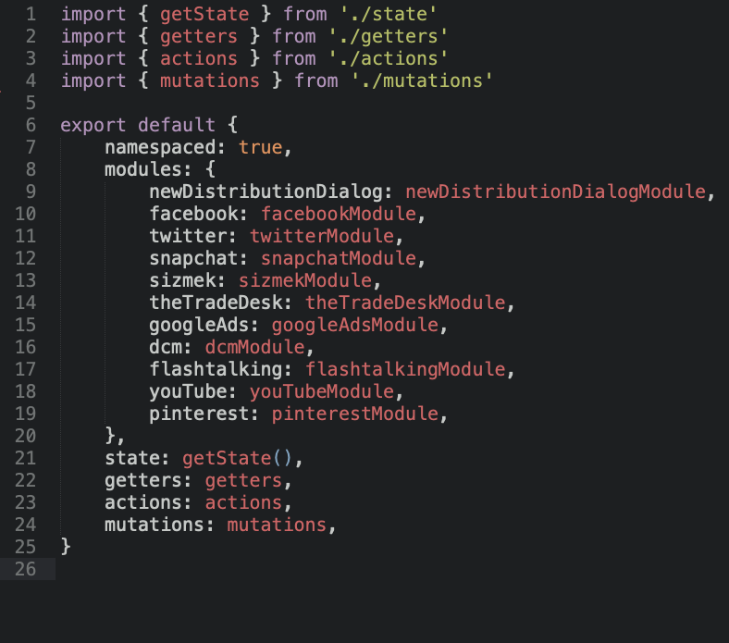
Distribution Store
Notes:
Let’s take a look at the example of the business logic of the distribution page we looked at before.
We can see it’s nicely divided into modules - by distribution platforms

Slide 34
What is the catch?
Modules have a lot of similarities
Modules have quite some differences
Defining what’s shared
Notes:
So what is the catch?
Defining what goes into the shared state - above modules is usually the most difficult part. In this example that is even more visible as we’re dealing with some external platforms that have a lot of similarities but also a lot of differences.
We had to do a refactor on this end recently as well as we have repeated methods in different modules on one hand and we had super complex methods with special case handling in shared store.

Slide 35
repeating similar methods
vs.
over-generalizing
Notes:
Usually it’s a trade off between these two - repeating similar methods or similar parts of the code and over-generalizing other parts making them very complex and hard to understand and maintain.
A rule of thumb here for me would be to prefer repeating at first but never forgetting to look back at the decisions we’ve made in the past.

Slide 36
Conclusion

Slide 37
think how you would implement from scratch
&
be mindful of module size & responsibilities
Notes:
I only want you to take away those two things.
Always think how you would do this if there was no legacy.
It’s easy to just add another prop to a component. Or a bit of HTML with some computed props. But this is exactly the behavior that usually leads to unreadable and spaghetti components that do tens of things. If somebody would ask you how would you design a component with a specific set of functionalities you would spend some time thinking and you would probably come up with a good solution. But if somebody asks you to design a component with half the functionalities and then later asks you to add one extra functionality every month we tend to boil like frogs. We just keep adding stuff and never look at how we would do this today if there was no code written yet. Now I’m not saying a rewrite is due every month but we should at least think if the code still makes sense before mindlessly implementing an additional set of features.
Be critical of component/module sizes & responsibilities.
You should always be asking yourselves these questions:
How long is the template?
How long is the styling? Maybe a shared and separated file?
How many props does a component have? Do they all make sense?
How many things does the component do?
And remember - everything we talked about applies outside of components - same goes for store - split into more modules when it makes sense. And in fact, everything we talked about applies outside Vue.js really. We just explained it on Vue.js examples.

Slide 38


